Slide 1
Survey on Cryptanalysis of AES
Bryce Hickle

Slide 2
Introduction
AES is a private key encryption standard approved by the U.S government
Block size: 128b, Key size: 128b, 192b, 256b
Substitution, Permutation structure
It was designed to be asymptotically secure
Surveying Cryptanalysis of AES will help us to see if there are any systematic weakness in AES and how AES may be exploited in the future

Slide 3
Linear Cryptanalysis
If an encryption scheme can be modeled as a linear transformation between the message and the cipher, linear cryptanalysis can break scheme easily
Created by Matsui in 1990s.
Is a known-plaintext attack
For example, if AES was completely linear with one round:
One could gather enough plaintext-ciphertext pairs (128)
Perform Gaussian Elimination to solve k variables

Slide 4
Linear Cryptanalysis
Known at time of development of AES
Use of S-boxes make AES non-linear and therefore immune to Linear Cryptanalysis
Systematically, crack S-boxes of AES, crack AES

Slide 5
Differential Cryptanalysis
Created in 1980s
First technique to achieve a better than brute force approach against DES
Main idea, as long as a scheme is not perfectly secure, there will be some "negligible" amount of dependence or statistical behavior that’s not expected
Uses this principle to rigorously test for non-uniform variance in the form of differentials
Chosen plaintext attack

Slide 6
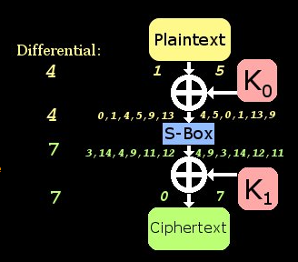
Differential Cryptanalysis Toy Example

Slide 7
Differential Cryptanalysis
Operation:
Calculate delta x and delta y for as many pairs of input and output as possible
Once a non-uniform anomaly is found:
Generate sets of pairs of plaintext that have delta x
Test a set of keys to see if they produce corresponding delta y
AES uses linear diffusion and good choices of S-box element for very good uniform behavior
AES is currently secure from Differential Cryptanalysis

Slide 8
Algebraic Cryptanalysis
Abstraction of linear cryptanalysis
Three techniques in algebraic cryptanalysis are Groebner Basis approach, XL family of algorithms, and BES
Model AES as a system of multivariate quadratic equations (MQ equations) and attempts to solve for the keys

Slide 9
Algebraic Cryptanalysis (Groebner Basis)
Abstraction of linear cryptanalysis
Models AES as MQ problem
Finds a Groebner Basis using Buchberger Algorithm
Puts MQ system in respect to found Groebner Basis
Can break AES in 2^255 asymptotically
AES remains asymptotically secure

Slide 10
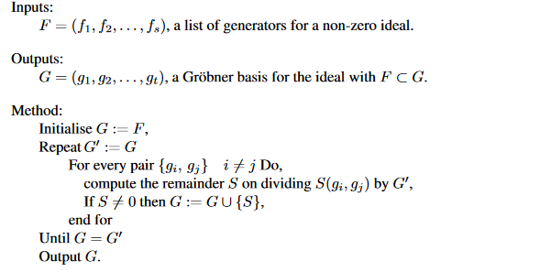
Buchberger Algorithm

Slide 11
Algebraic Cryptanalysis (XL and XSL)
Abstraction of linear cryptanalysis
Models AES as MQ problem
XL uses principle of relinearization
XSL uses principle of relinearization, T method, and T' Method
T and T' method attempt to increase number of equations and removing variables to optimize approach
T' method debated still
With T' method in XSL, AES-256 can be broken 2^255 asymptotically

Slide 12
Algebraic Cryptanalysis (BES)
Abstraction of linear cryptanalysis
Models AES as MQ problem
Uses same approach as XSL but its system is entirely in GF(2^8)
This approach can break AES-128 in 2^100 asymptotically
Practically infeasible today but still quite a breakthrough (if T' method holds)

Slide 13
Neural Network Cryptanalysis
Recently Neural Networks Used in known-plaintext attack of AES
Able to predict up to 89 percent similarity overall based on MSE metric
Did not provide full source code, in-detail algorithm, etc.
Attempt to verify experiment by making a neural network in Python based on the paper

Slide 14
Neural Network Cryptanalysis
Recently Neural Networks Used in known-plaintext attack of AES
Able to predict up to 89 percent similarity overall based on MSE metric
Did not provide full source code, in-detail algorithm, etc.
Attempt to verify experiment by making a neural network in Python based on the paper

Slide 15
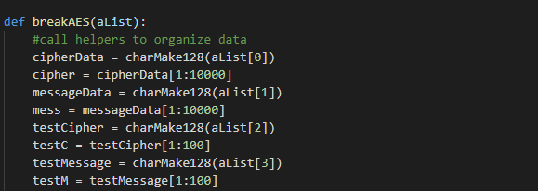
Neural Network Cryptanalysis

Slide 16
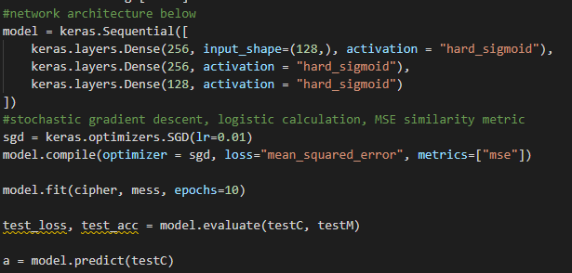
Neural Network Cryptanalysis

Slide 17
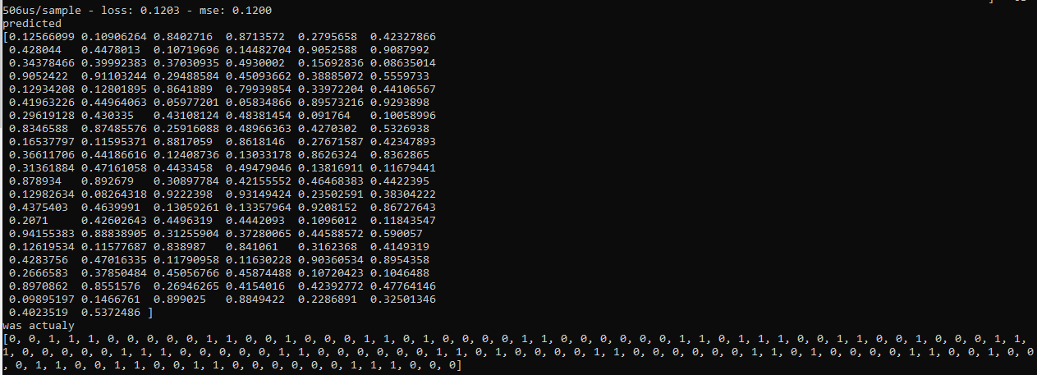
Neural Network Cryptanalysis

Slide 18
Conclusion
AES is still currently considered secure and in use
Consensus on T' method may lead AES to a similar fate as DES in the near future (especially for AES-128)
It's possible that a full break from Neural Network Cryptanalysis could occur in the future as well

Slide 19
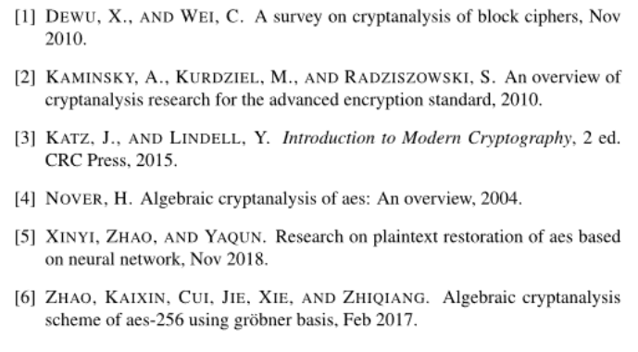
References

Slide 20
Image Credit
Buchberger algorithm:
http://www.maths.qmul.ac.uk/~whitty/LSBU/MathsStudyGroup/Buchberger.pdf
Differential Cryptanalysis Toy Example
http://theamazingking.com/crypto-diff.php

